Slide 1
Semester:II Course Title: Machine Learning Semester:II Course Title: Machine Learning
Course Code : 05BMSIT23265 Credits : 4
UNIT 1 - INTRODUCTION TO ML

Slide 2
Defi
MACHINE LEARNING IS A SUBSET OF AI WHICH ENABLES TO IMPROVE AT TASKS WITH EXPERIENCE
ARTHUR SAMUEL 1959
EXYRACTION OF KNOWLEDGE FROM DATA.
LEARNS FROM BEHAVIOUR AND MAKE PREDICTIONS.

Slide 3
UNIT 1 - INTRODUCTION TO ML
Machine learning is about extracting knowledge from data. It is a research field at the intersection of statistics, artificial intelligence, and computer science and is also known as predictive analytics or statistical learning.
The application of machine learning methods has in recent years become ubiquitous in everyday life.
From auto‐ matic recommendations of which movies to watch.
to what food to order or which products to buy, to personalized online radio and
recognizing your friends in your photos, many modern websites
and devices have machine learning algorithms at their core.
When you look at a complex website like Facebook, Amazon, or Netflix, it is very likely that every part of the site contains multiple machine learning models.

Slide 4
Why Machine Learning?
In the early days of “intelligent” applications, many systems used handcoded rules of “if ” and “else” decisions to process data or adjust to user input.
Think of a spam filter whose job is to move the appropriate incoming email messages to a spam folder.
You could make up a blacklist of words that would result in an email being marked as 1 spam. This would be an example of using an expert-designed rule system to design an “intelligent” application.

Slide 5
Problems Machine Learning Can Solve
The most successful kinds of machine learning algorithms are those that automate decision-making processes by generalizing from known examples.
Going back to our example of spam classification, using machine learning, the user provides the algorithm with a large number of emails (which are the input), together with information about whether any of these emails are spam (which is the desired output).

Slide 6
Applications of machine learning
1. Predictive Analytics: Sales Forecasting, Customer Churn Prediction
Risk Assessment, Demand Forecasting.
2. Image and Speech Recognition:
Facial Recognition, Object Detection, Speech Recognition, Image Captioning
3. Recommendation Systems:Product Recommendations, Content Recommendations, Social Media News Feeds
4. Fraud Detection: Financial Fraud, Cybersecurity
5. Autonomous Vehicles: Self-Driving Cars, Robotics
6. Healthcare:Disease Diagnosis, Drug Discovery, Personalized Medicine

Slide 7
Why Python?
Python has become the lingua franca for many data science applications.
It combines the power of general-purpose programming languages with the ease of use of domain-specific scripting languages like MATLAB or R. Python has libraries for data loading, visualization, statistics, natural language processing, image processing, and more.
This vast toolbox provides data scientists with a large array of general- and special-purpose functionality.
Advantage: ability to interact directly with code.
As a general-purpose programming language, Python also allows for the creation of complex graphical user interfaces (GUIs) and web services, and for integration into existing systems.

Slide 8
CLASSIFICATION OF ML
Machine learning models can be broadly classified by their learning approach
1)Supervised
2) unsupervised or reinforcement learning

Slide 9
1. By Learning Approach:
Supervised Learning☹exact output
Models learn from labeled data to predict outcomes.
Classification: Predicts a categorical outcome (e.g., spam/not spam, image recognition).
Binary Classification: Predicts one of two possible outcomes (e.g., yes/no, 0/1).
Multiclass Classification: Predicts one of multiple possible outcomes.
Multilabel Classification: Predicts multiple labels for a single instance.
Regression: Predicts a continuous value (e.g., house price, temperature).
Unsupervised Learning: (there is no exactly output that we are predicting)
Grouping,similarities,relationships
Example: lot of cat and dog images it groups separatly
Models learn from unlabeled data to find patterns and structures.
Clustering: Groups similar data points together.
Dimensionality Reduction: Reduces the number of variables while retaining important information.
Example: age and date of birth of customer it’s a redundant
salary of month,annual income redundant
So reducing the no of dimentions,features in retaining the important information.

Slide 10
Reinforcement Learning:
Models learn through trial and error, receiving rewards or penalties for their actions.
It completely focus on feed back feed back can be positive(reward) or negative(penalties).

Slide 11
Explain the difference between traditional programming and machine learning.
Traditional programming involves writing explicit instructions for a computer to follow,
while machine learning focuses on algorithms that allow computers to learn from data and make predictions or decisions without being explicitly programmed.
Approach to Problem Solving:
Data Dependency:
Flexibility and Adaptability
Problem Complexity:
Development Process:
Outcome Predictability:

Slide 12
Compare ML with artificial intelligence and explain their relationship.
Artificial Intelligence (AI) is the broad concept of enabling machines to perform tasks that typically require human intelligence,
while Machine Learning (ML) is a specific subset of AI that focuses on algorithms that allow systems to learn from data without explicit programming.

Slide 13
Regression
Example : exact price of housein numbers
Temperature exact prediction
* classification:
-affordable
-mid-range
-luxury
Predicting weather sunny rainy and cloudy

Slide 14
List common algorithms used for classification tasks.
Common algorithms for classification tasks include
Logistic Regression,
Naive Bayes, K-Nearest Neighbors (KNN),
Decision Trees,
Random Forests, and
Support Vector Machines (SVM).

Slide 15
Regression algorithms in machine learning
Introduction- Regression Algorithms in Machine Learning-
Subtitle: Predicting Continuous Outcomes-
What is Regression?
Definition: Regression is a type of supervised learning algorithm that predicts continuous outcomes.
Examples: Predicting house prices, stock prices, or temperatures.

Slide 16
Types of regressions
Simple Linear Regression:
One independent variable predicts the outcome.
Multiple Linear Regression: Multiple independent variables predict the outcome.
Polynomial Regression: Non-linear relationships between variables.
Linear Regression- Equation: y = β0 + β1x + ε- Goal: Find the best-fitting line that minimizes the sum of squared errors.
Regression Metrics-
Mean Absolute Error (MAE): Average of the absolute differences.-
Mean Squared Error (MSE): Average of the squared differences.-
R-Squared (R²): Proportion of variance explained by the model.

Slide 17
Applications
- Predicting Continuous Outcomes: Regression algorithms are useful for predicting continuous outcomes such as house prices, stock prices, or temperatures.
Forecasting: Regression algorithms can be used for forecasting future values based on historical data
Conclusion- Summary: Regression algorithms are a powerful tool for predicting continuous outcomes.

Slide 18
Regression algorithms are
Here are some common types of regression algorithms:
1. Linear Regression- Simple Linear Regression: One independent variable predicts the outcome.
- Multiple Linear Regression: Multiple independent variables predict the outcome
.2. Polynomial Regression-
Quadratic Regression: A polynomial of degree 2 is used to fit the data.-
Cubic Regression: A polynomial of degree 3 is used to fit the data
.3. Ridge Regression-
L2 Regularization: Adds a penalty term to the cost function for large coefficients.
4. Lasso Regression-
L1 Regularization: Adds a penalty term to the cost function for large coefficients.
5. Elastic Net Regression- Combination of L1 and L2 Regularization: Adds both penalty terms to the cost function.
6. Decision Tree Regression- Tree-based model: Uses a decision tree to predict continuous outcomes.
7. Random Forest Regression- Ensemble model: Combines multiple decision trees to improve predictions.

Slide 19
Cont….
8. Support Vector Regression (SVR)- Kernel-based model: Uses a kernel function to map data to a higher-dimensional space.
9. Gradient Boosting Regression- Ensemble model: Combines multiple weak models to create a strong predictive model.
10. Bayesian Regression- Probabilistic model: Uses Bayesian inference to estimate model parameters.
11. Poisson Regression- Count data model: Used for predicting count data, such as the number of events.
12. Logistic Regression (for binary classification problems with a regression twist)- Sigmoid function: Used to predict probabilities of binary outcomes.
Each type of regression algorithm has its strengths and weaknesses, and the choice of algorithm depends on the specific problem and data characteristics

Slide 20
Linear regression algorithm
- Linear Regression Algorithm in Machine Learning-
Subtitle: Predicting Continuous Outcomes
What is Linear Regression?-
Definition: Linear regression is a type of supervised learning algorithm that predicts continuous outcomes.-
Equation: y = β0 + β1x + ε
Y=mx+c

Slide 21
How Linear Regression Works-
Simple Linear Regression: One independent variable predicts the outcome.-
Multiple Linear Regression: Multiple independent variables predict the outcome.

Slide 22
Assumptions of Linear Regression
- Linearity: The relationship between the independent variable(s) and the dependent variable is linear.-
Independence: Each observation is independent of the others
.- Homoscedasticity: The variance of the residuals is constant across all levels of the independent variable(s).
- Normality: The residuals are normally distributed.-
No multicollinearity: The independent variables are not highly correlated with each other

Slide 23
Cost Function
- Mean Squared Error (MSE): Average of the squared differences between predicted and actual values.-
Goal: Minimize the MSE to find the best-fitting line
Gradient Descent
Optimization algorithm: Used to minimize the cost function.
- Types: Batch gradient descent, stochastic gradient descent, and mini-batch gradient descent

Slide 24
Coefficient Interpretation
- β0 (Intercept): The expected value of the dependent variable when the independent variable(s) is/are 0.
- β1 (Slope): The change in the dependent variable for a one-unit change in the independent variable

Slide 25
Evaluation Metrics
- R-Squared (R²): Proportion of variance explained by the model.
- Mean Absolute Error (MAE): Average of the absolute differences between predicted and actual values.
- Mean Squared Error (MSE): Average of the squared differences between predicted and actual values

Slide 26
Applications
- Predicting continuous outcomes: Linear regression is useful for predicting continuous outcomes such as house prices, stock prices, or temperatures.
- Forecasting: Linear regression can be used for forecasting future values based on historical data

Slide 27
Conclusion
- Summary: Linear regression is a powerful algorithm for predicting continuous outcomes.- Image: A relevant diagram or graphic

Slide 28
Classification Algorithms in Machine Learning
Predicting Categorical Outcomes
What is Classification?
Definition: Classification is a type of supervised learning algorithm that predicts categorical outcomes.
Examples: Spam vs. not spam emails, cancer diagnosis, product recommendation.
Types of Classification-
Binary Classification: Two classes or categories.-
Multi-Class Classification: More than two classes or categories.

Slide 29
Classification Algorithms
Logistic Regression: A popular algorithm for binary classification problems.
Decision Trees: A tree-based model that uses a decision tree to classify data.
Random Forest: An ensemble model that combines multiple decision trees.
Support Vector Machines (SVMs): A kernel-based model that finds the hyperplane that maximally separates the classes.

Slide 30
Evaluation Metrics
- Accuracy: Proportion of correctly classified instances.
- Precision: Proportion of true positives among all positive predictions.-
Recall: Proportion of true positives among all actual positive instances.-
F1-score: Harmonic mean of precision and recall.

Slide 31
Applications
- Image classification: Classification algorithms can be used for image classification tasks such as object recognition.
- Text classification: Classification algorithms can be used for text classification tasks such as spam detection.
- Medical diagnosis: Classification algorithms can be used for medical diagnosis tasks such as cancer diagnosis

Slide 32
Conclusion
Summary: Classification algorithms are a powerful tool for predicting categorical outcomes.

Slide 33
Logistic Regression Algorithm
A Popular Algorithm for Binary Classification
What is Logistic Regression?
Definition: Logistic regression is a type of supervised learning algorithm that predicts binary outcomes.
Examples: Spam vs. not spam emails, cancer diagnosis, credit risk assessment.

Slide 34
How Logistic Regression Works
Sigmoid function: Used to predict probabilities of binary outcomes.
Logit function: Used to model the relationship between the independent variables and the log odds of the outcome.
Logistic Regression Equation
Equation: P(Y=1|X) = 1 / (1 + e^(-z))
- Where z = β0 + β1X1 + … + βnXn

Slide 35
Cost Function
Log loss function: Used to measure the difference between predicted and actual outcomes.
Goal: Minimize the log loss function to find the best-fitting model.
Evaluation Metrics
Accuracy: Proportion of correctly classified instances.
Precision: Proportion of true positives among all positive predictions.-
Recall: Proportion of true positives among all actual positive instances.-
F1-score: Harmonic mean of precision and recall.

Slide 36
Advantages
Interpretable results: Logistic regression provides interpretable results, including odds ratios and confidence intervals.
- Easy to implement: Logistic regression is a well-established algorithm with many software implementations.
Applications
Credit risk assessment: Logistic regression can be used to predict the likelihood of loan default.
- Medical diagnosis: Logistic regression can be used to predict the likelihood of disease diagnosis.
- Marketing: Logistic regression can be used to predict customer churn or response to marketing campaigns

Slide 37
Conclusion
Logistic regression is a powerful algorithm for binary classification problems.

Slide 38
Unsupervised Learning
What is Unsupervised Learning?
Definition: Machine learning technique where the model learns patterns from unlabeled data (no predefined categories or outputs).
Goal: Discover hidden structures, relationships, or patterns in data.
Key idea: The model tries to understand the underlying structure without guidance.

Slide 39
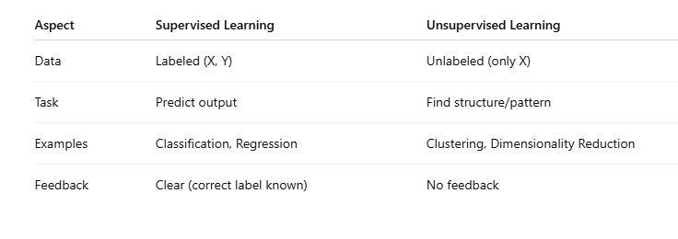
Differences: Supervised vs Unsupervised Learning

Slide 40
Types of Unsupervised Learning
a) Clustering
Group similar data points together.
No predefined categories.
Example algorithms:
K-Means
Hierarchical Clustering
DBSCAN
Use cases: Customer segmentation, document clustering.

Slide 41
b) Dimensionality Reduction
Reduce the number of features while retaining important information.
Helps with visualization, noise removal, compression.
Example algorithms:
PCA (Principal Component Analysis)
t-SNE (t-distributed Stochastic Neighbor Embedding)
UMAP (Uniform Manifold Approximation and Projection)
Use cases: Data visualization, speeding up machine learning models.

Slide 42
c) Association Rule Learning
Discover interesting relations between variables.
Example algorithms:
Apriori
Eclat
Use cases: Market basket analysis (e.g., "People who buy bread also buy butter")

Slide 43
Key Algorithms Explained Simply
K-Means Clustering
Partition data into K groups.
Each group is centered around a centroid.
Objective: Minimize distance of points from their cluster centroid
Steps:
Randomly choose K centroids.
Assign each point to the nearest centroid.
Update centroids based on cluster members.
Repeat until convergence.

Slide 44
Hierarchical Clustering
Build a tree of clusters (called dendrogram).
Two types:
Agglomerative (bottom-up merging)
Divisive (top-down splitting)
Does not require specifying the number of clusters initially

Slide 45
PCA (Principal Component Analysis)
Mathematical technique to reduce dimensions.
Transforms original features into principal components (new axes capturing maximum variance).
Goal:
Keep important patterns
Discard noise or redundant information

Slide 46
Challenges in Unsupervised Learning
No clear metric to measure success (no true labels).
Choosing the number of clusters/components.
Interpretation of clusters or reduced dimensions can be subjective.
Sensitive to outliers and noise.

Slide 47
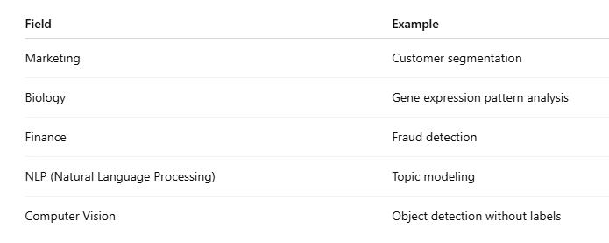
Applications of Unsupervised Learning

Slide 48
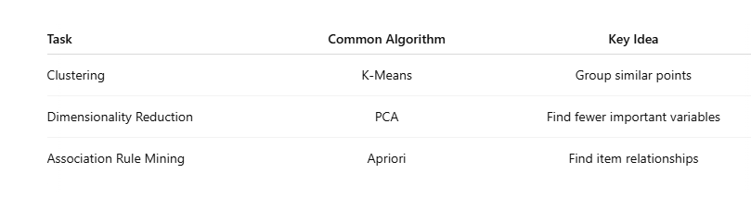
QUICH SUMMARY

